Slide 1


Back
to
Basics
A SMARTer Psych Assessment
for Your Community
Seth Thomas, MD, FACEP
October 28, 2017

Slide 2
1905

Slide 3
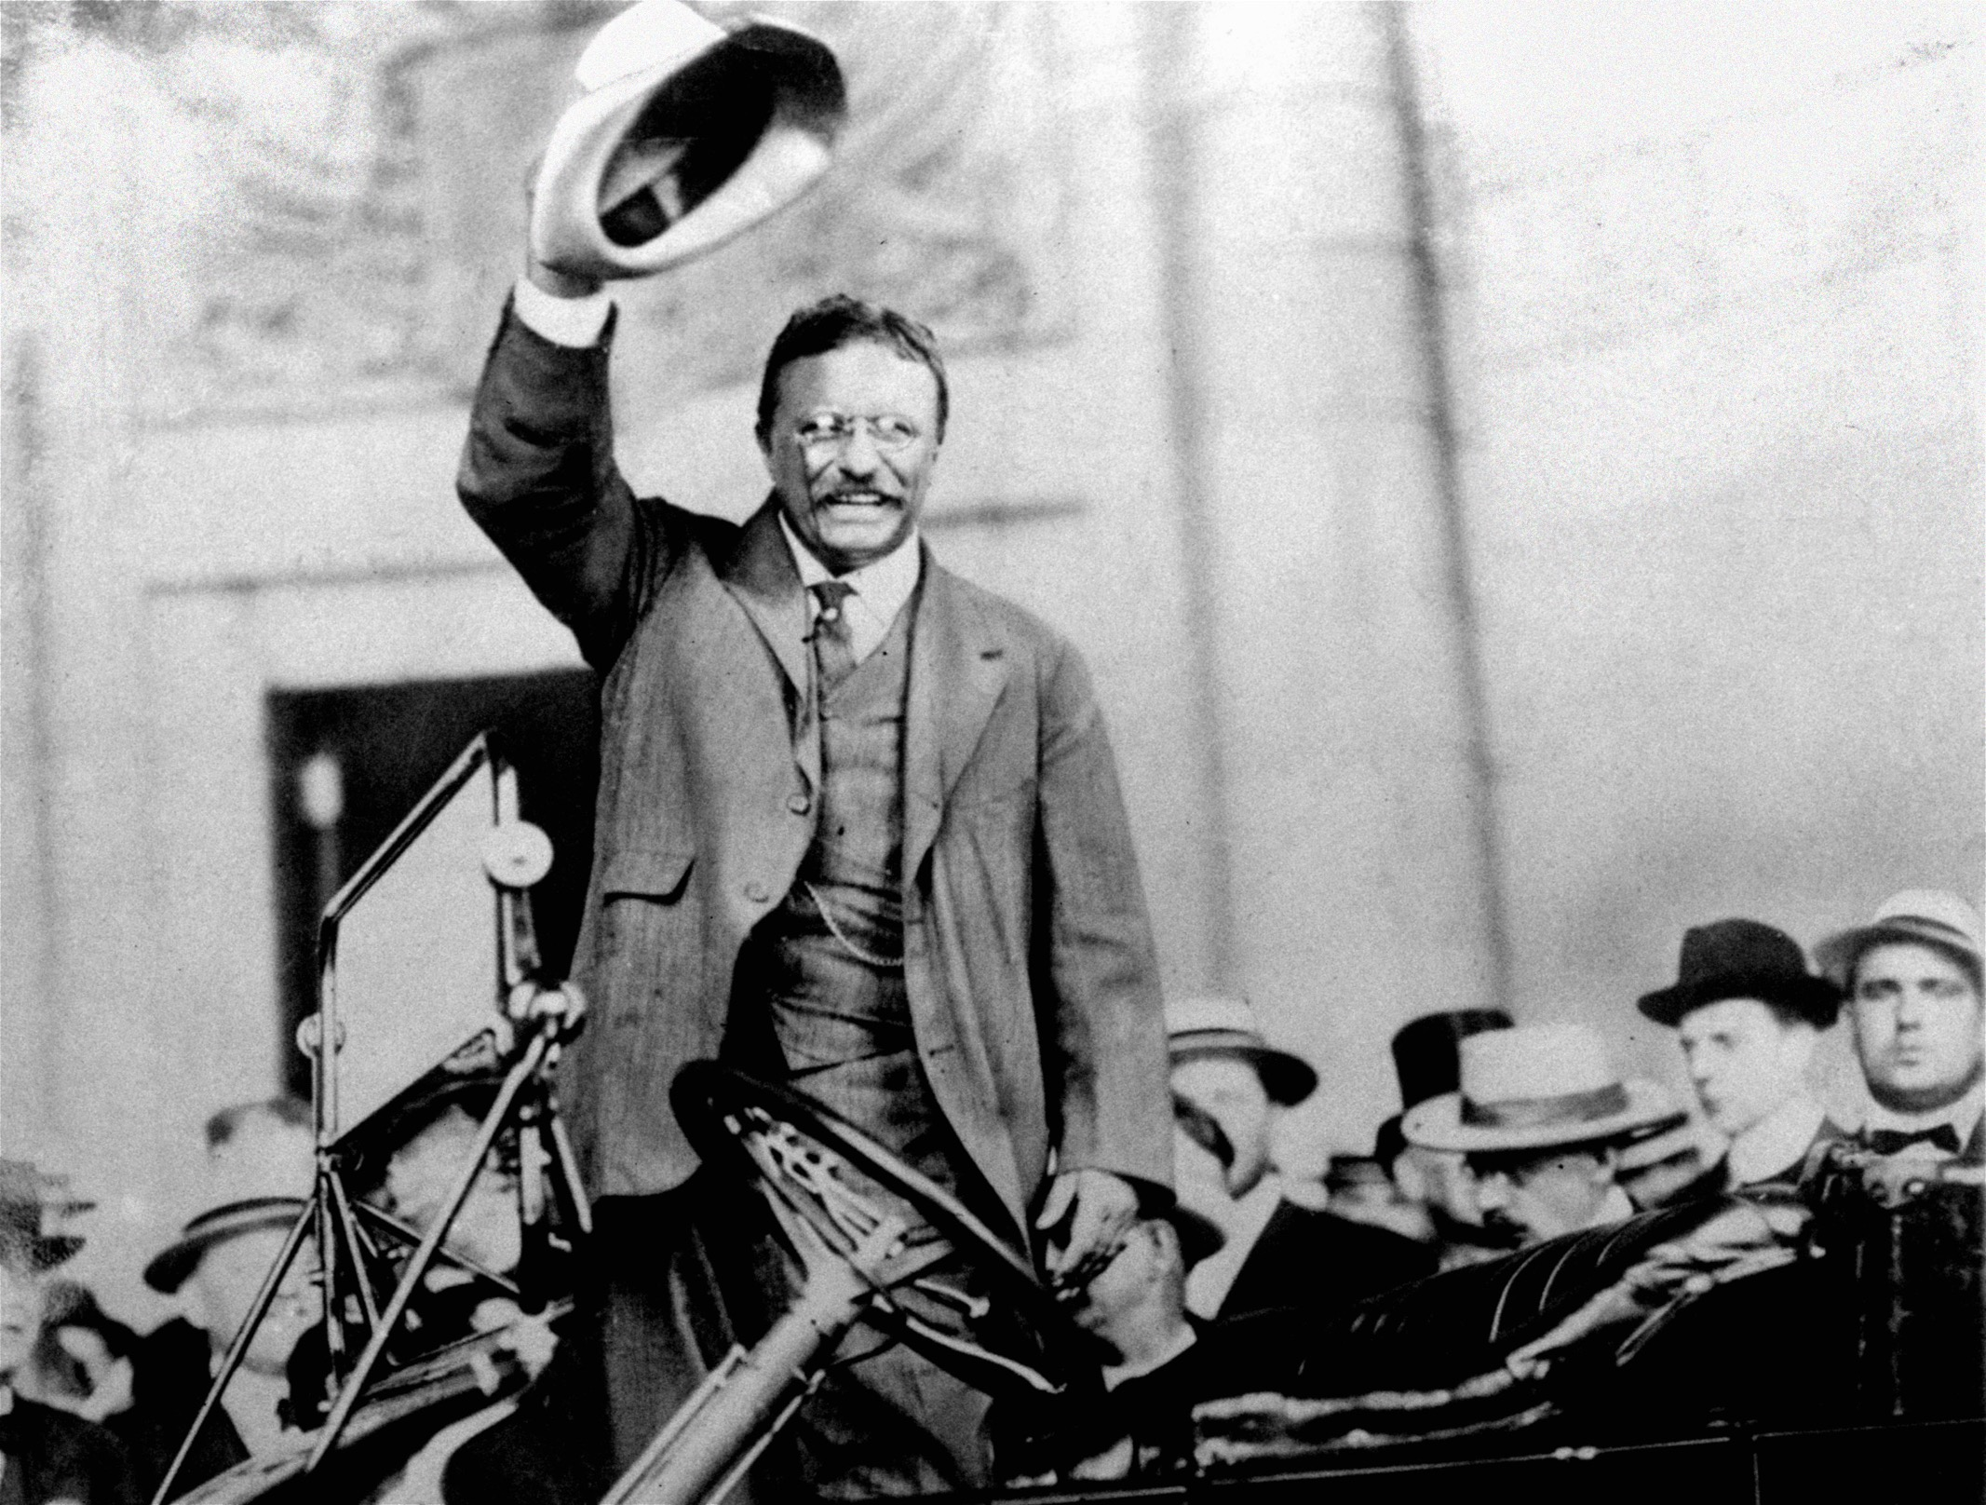
Notes:
It was 1905. The year that Teddy Roosevelt would be sworn in for his first “full” term as president of the United States. Also the year that the City of Las Vegas was founded and if that wasn’t enough, Einstein published his theory of special relativity. The world was on the move to becoming a modern society.

Slide 4
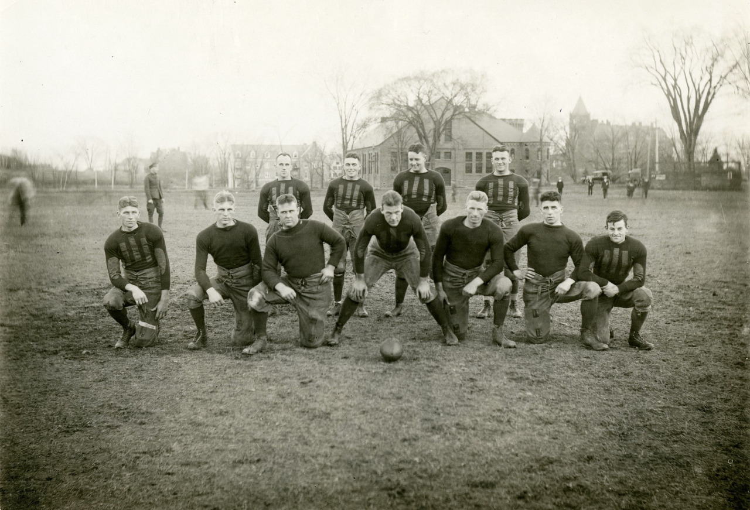

Slide 5
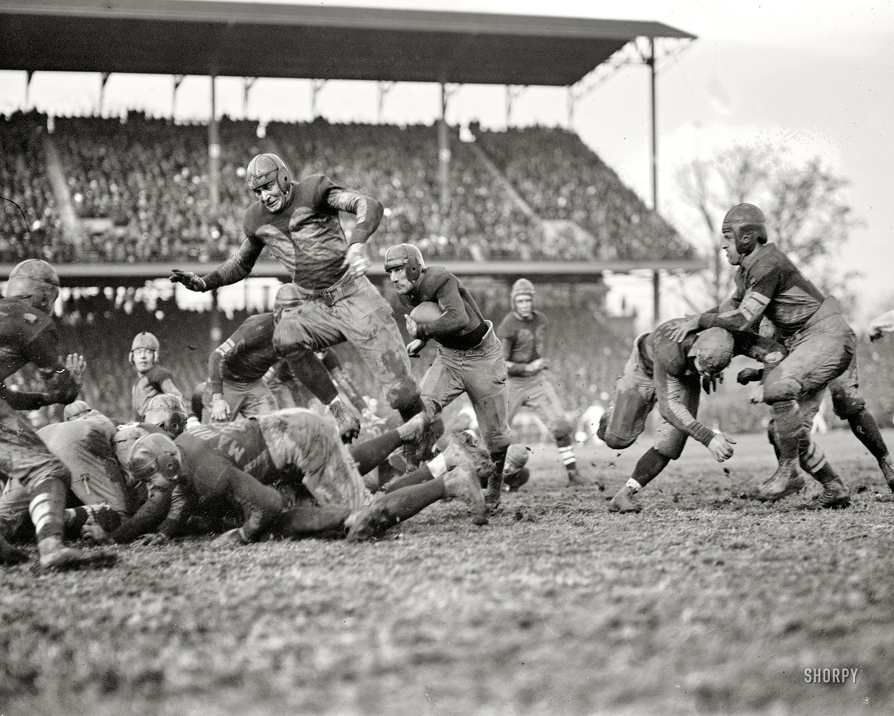
Notes:
Brutal game:
20 deaths in 1905 alone:
Roosevelt: ““Brutality in playing a game should awaken the heartiest and most plainly shown contempt for the player guilty of it.”
Had to choose rules that:
Reasonably protected players
Didn’t overly constrain the game
Allowed for judgement

Slide 6

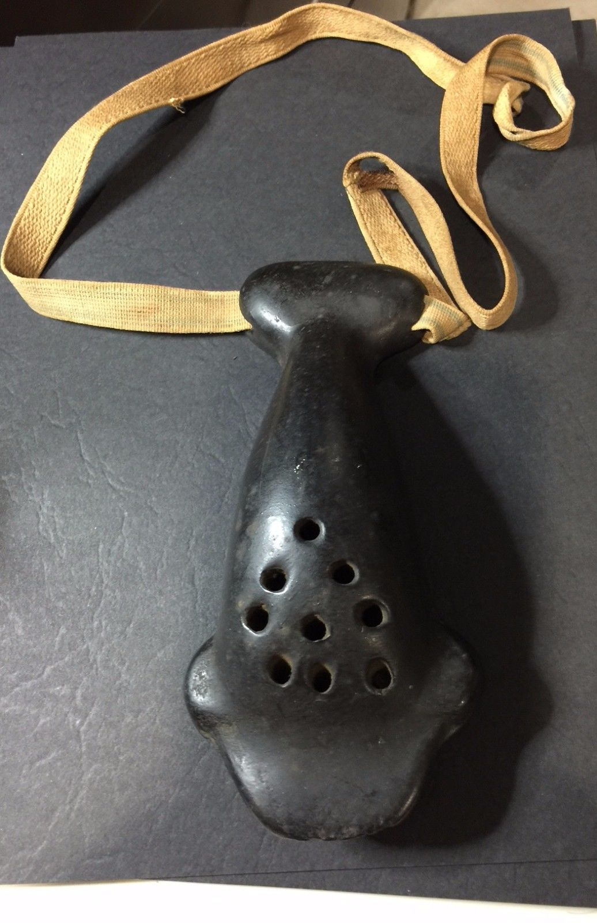
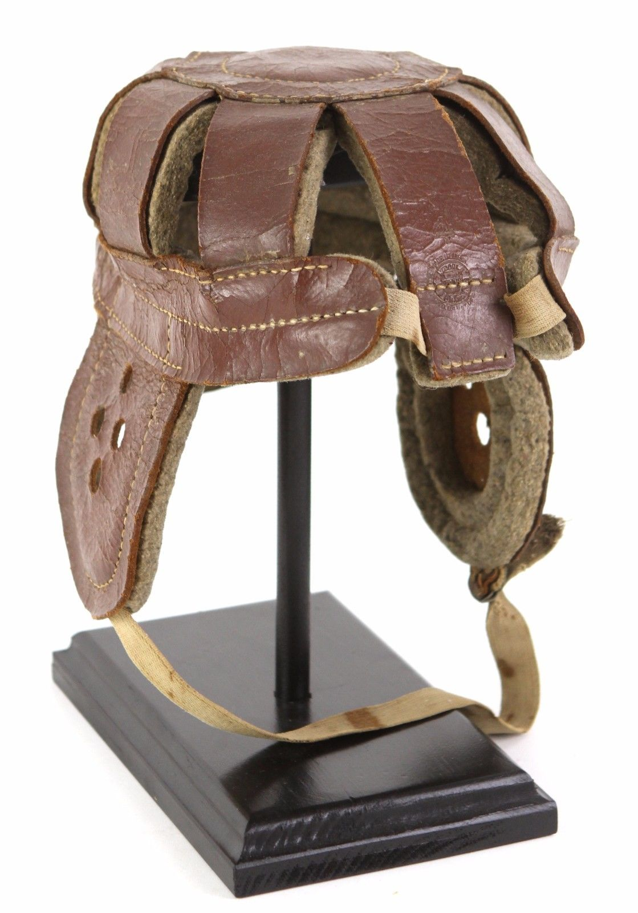

Slide 7
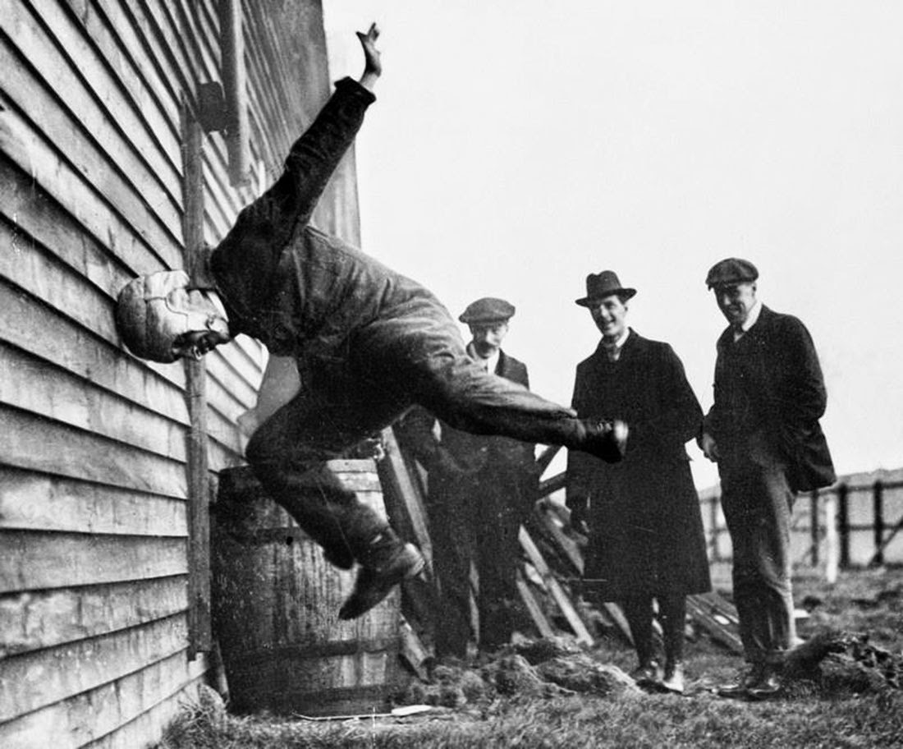

Slide 8
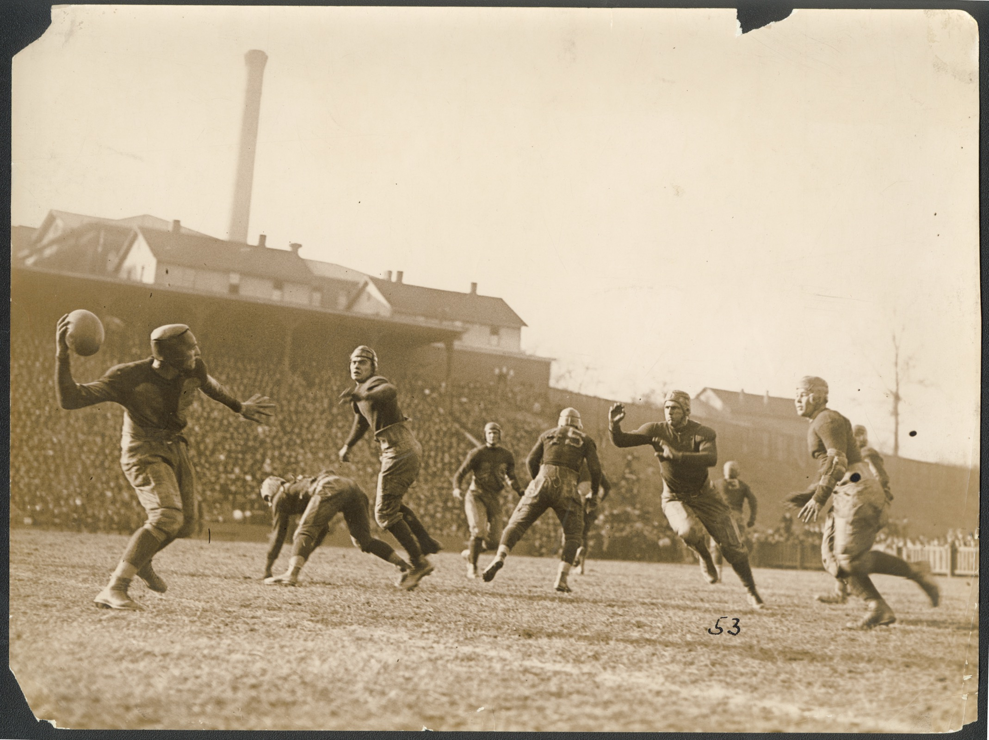
Forward pass
Wide receiver
Notes:
New rules added new expectations and a means of communication:
Forward passes
Moving the ball 10 yards instead of 5 in 3 downs
Wide receiver
Stopping the game when a player fell on the ball
Kicking the ball downfield

Slide 10
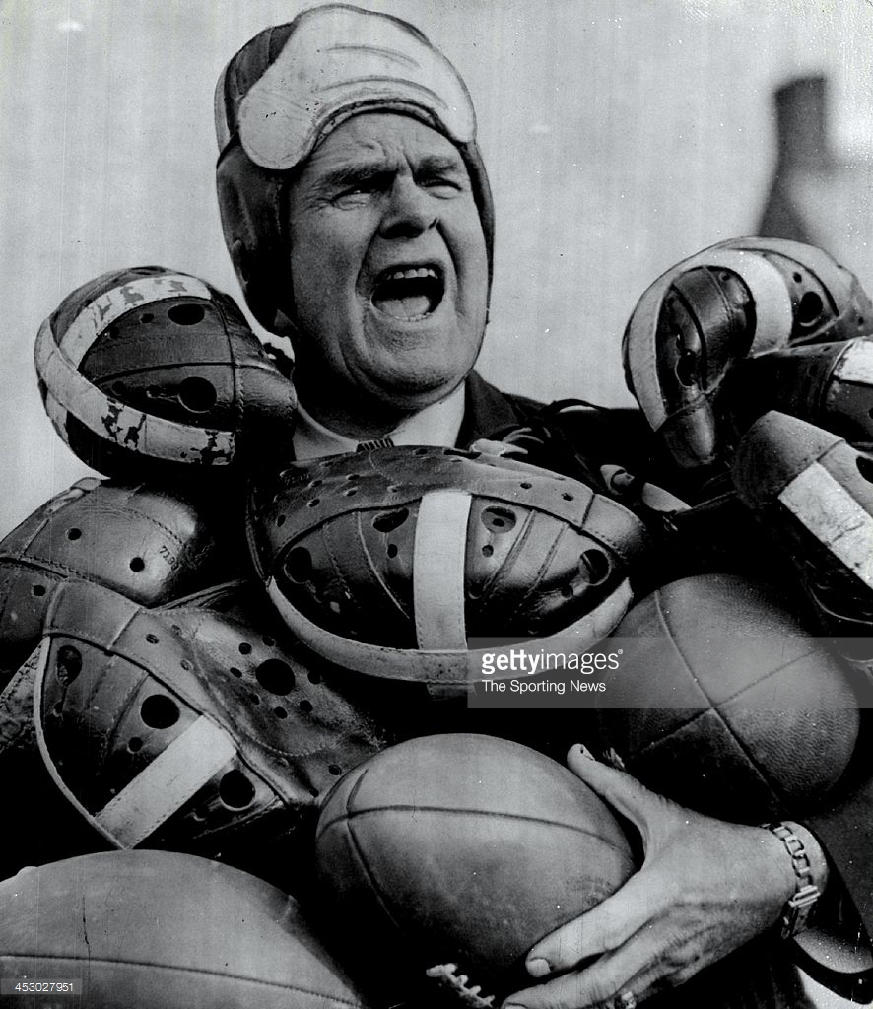
Notes:
Glenn Scobey “Pop” Warner was a prankster and popularized the use of the forward pass

Slide 11
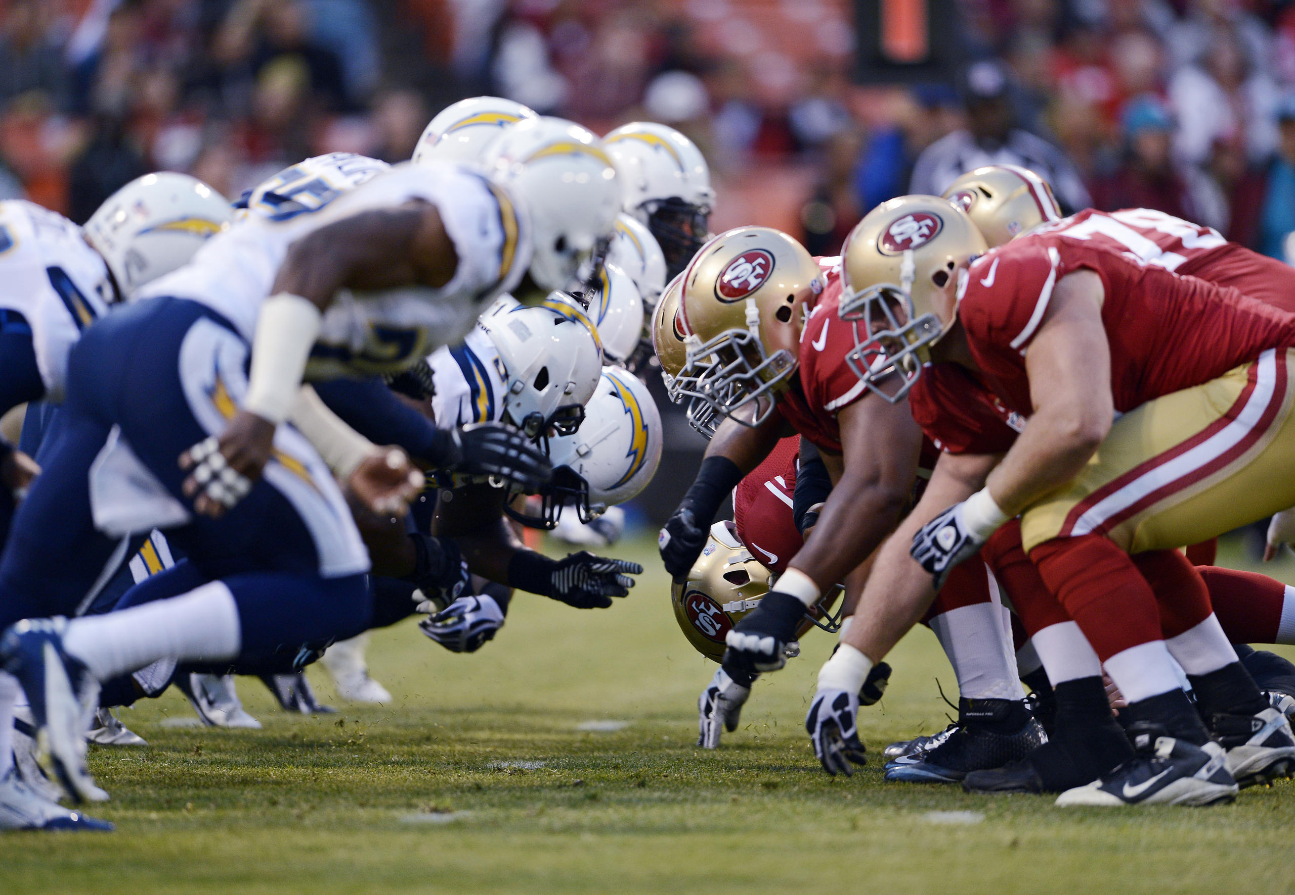

Slide 12
  Harm
  Delays
  Unnecessary suffering
  Increased costs
  Conflict
Notes:
Scrolling

Slide 13
2009

Slide 14
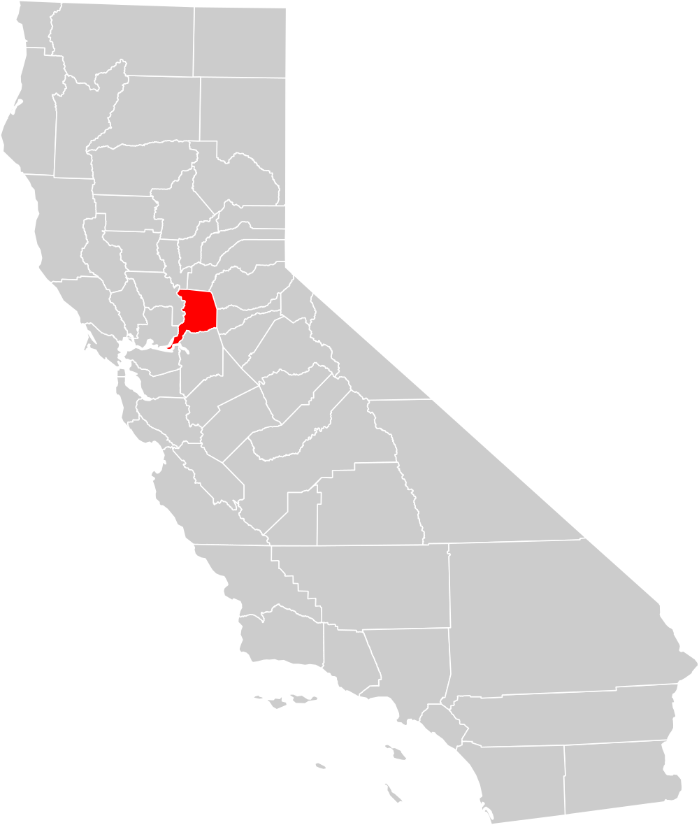
Sacramento County,
California
1,514,460 residents
7 EDs
~ 550,000 ED visits
~ 20,000 psych visits

Slide 15
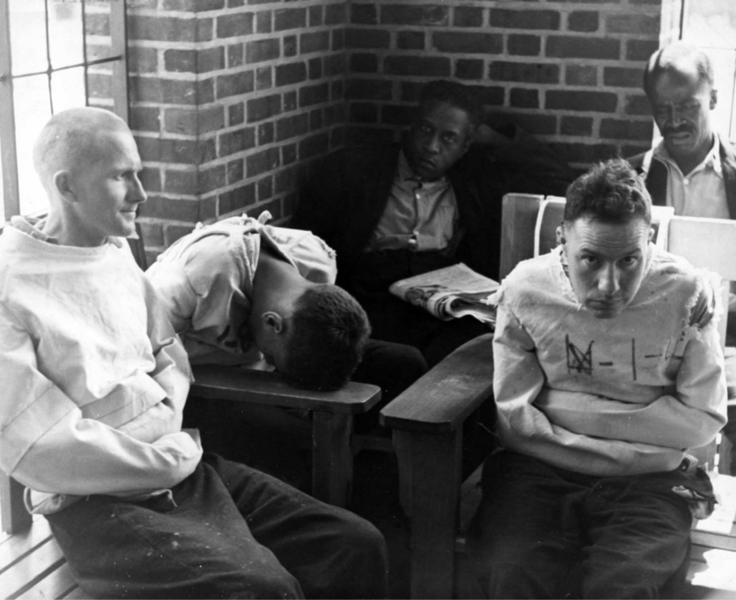
CBC
CMP
acetaminophen
salicylate
ethanol
urine drug screen
B-hCG
Notes:
1938

Slide 16
  W
  T
  F
  here’s
  he
  un?

Slide 17
  Clinical misses
  “Order and ignore” mentality
  MSE delays
  Lab overutilization & delays
  Increased diagnostic costs
  Numerous false positives
  Overtreatment and risk of harm
  Catheterizing patients for utox!
Notes:
Scrolling

Slide 18
Notes:
Could there be a panacea?
Can we find a magic bullet?
Is there a smarter way?
But what if there was a better way?
A method to guide you through the darkness, a way to help you find the answers without wasting resources?
What if there was an answer key to the test…
A template for each patient that would unlock the mystery…

Slide 19
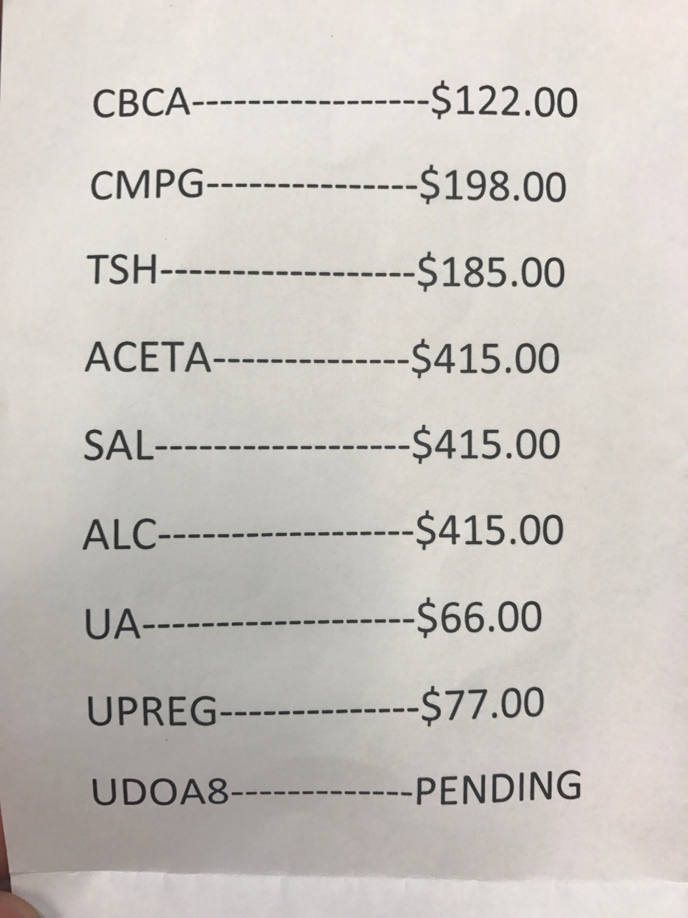
  $ 1,893
Notes:
Could there be a panacea?
Can we find a magic bullet?
Is there a smarter way?
But what if there was a better way?
A method to guide you through the darkness, a way to help you find the answers without wasting resources?
What if there was an answer key to the test…
A template for each patient that would unlock the mystery…

Slide 20
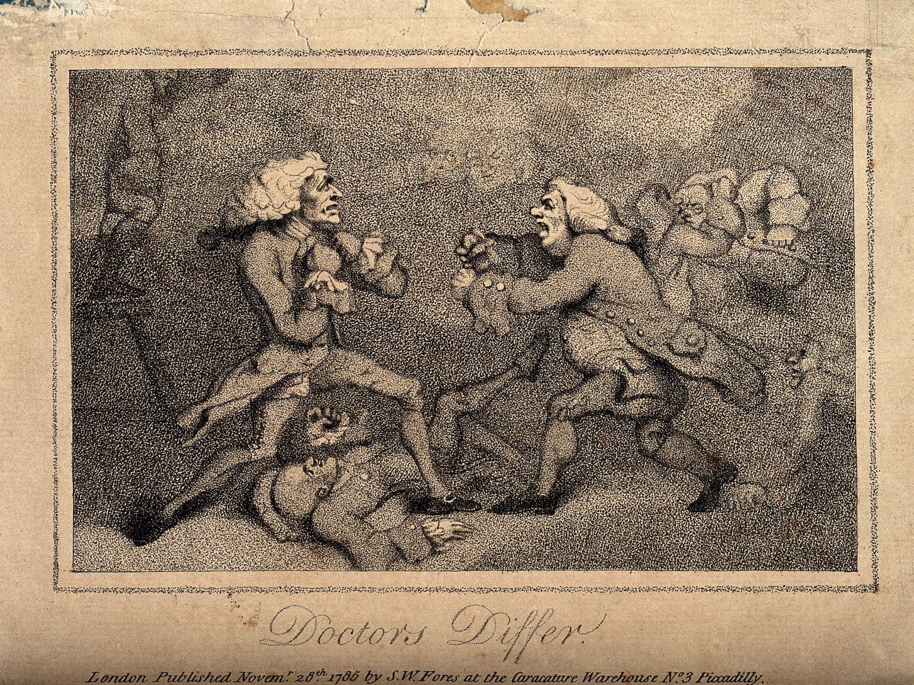
Notes:
There had to be a better way!

Slide 21
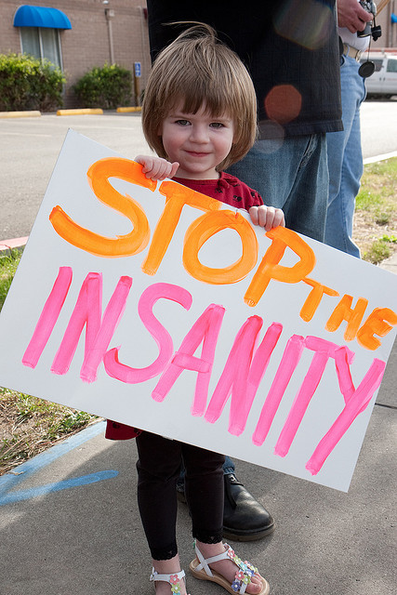
  Evidence-based
  Standardized
  Collaborative
Notes:
Could there be a panacea?
Can we find a magic bullet?
Is there a smarter way?
But what if there was a better way?
A method to guide you through the darkness, a way to help you find the answers without wasting resources?
What if there was an answer key to the test…
A template for each patient that would unlock the mystery…

Slide 22
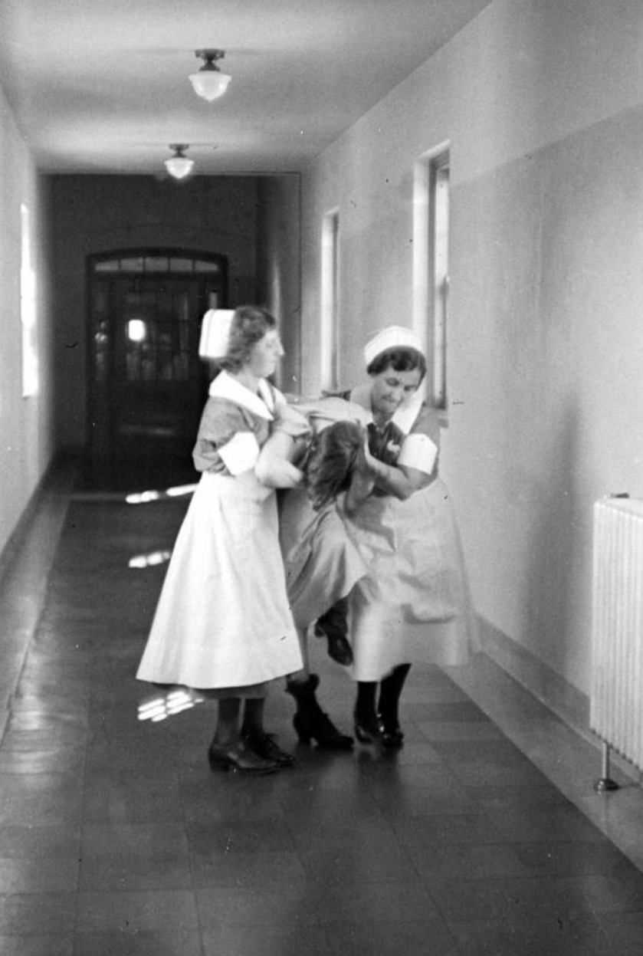
  Safety
  Consistency
  H&P skills
Notes:
Something that promotes safety and consistency
And takes us back to the basics where the History & Physical is once again in the driver’s seat

Slide 23
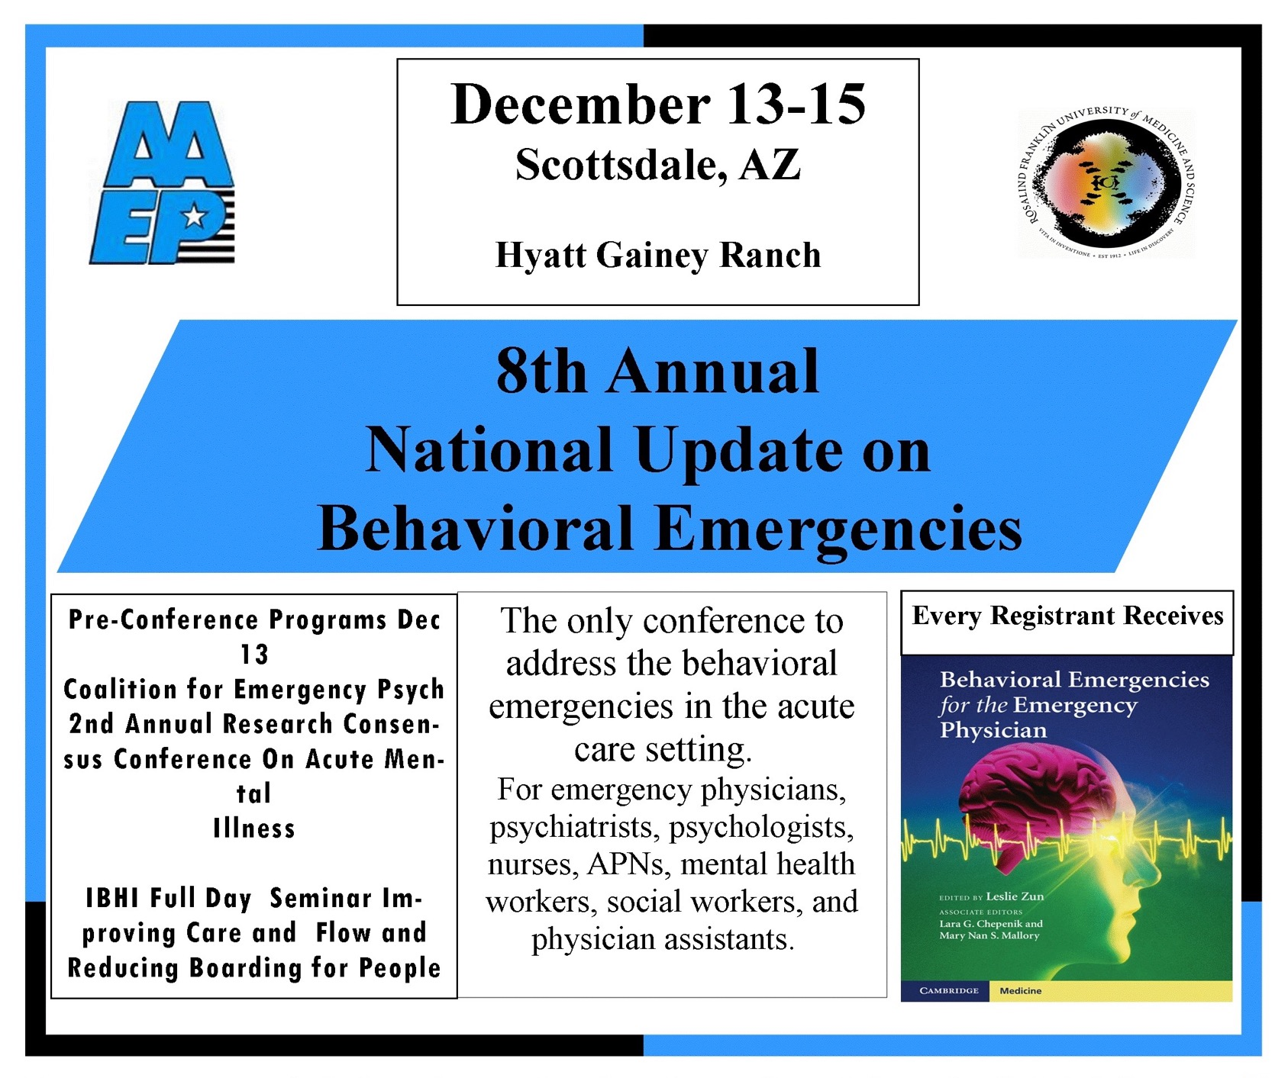
Notes:
Story of creation

Slide 24
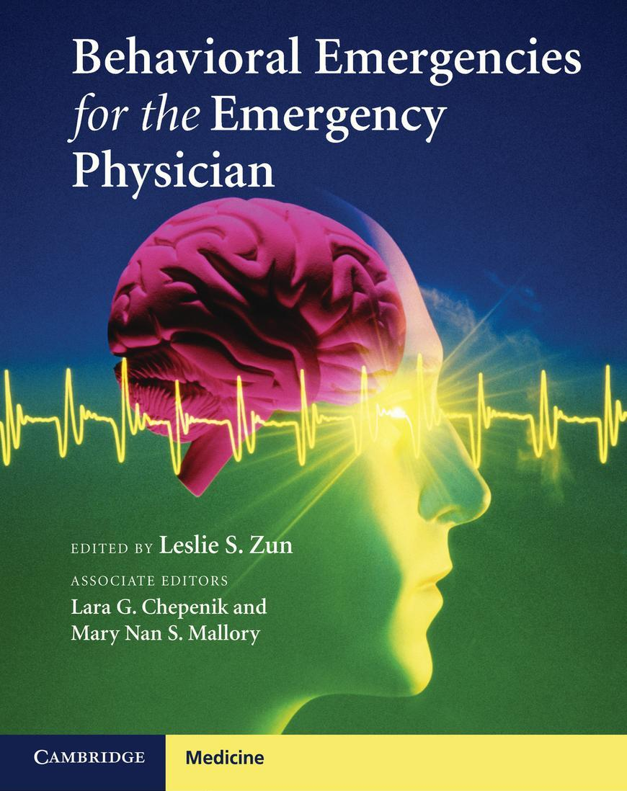
  New psychiatric condition?
  Active illness needing evaluation?
  Abnormal vital signs?
  Abnormal physical exam (unclothed)?
  Abnormal mental status?
Notes:
Story of creation

Slide 25

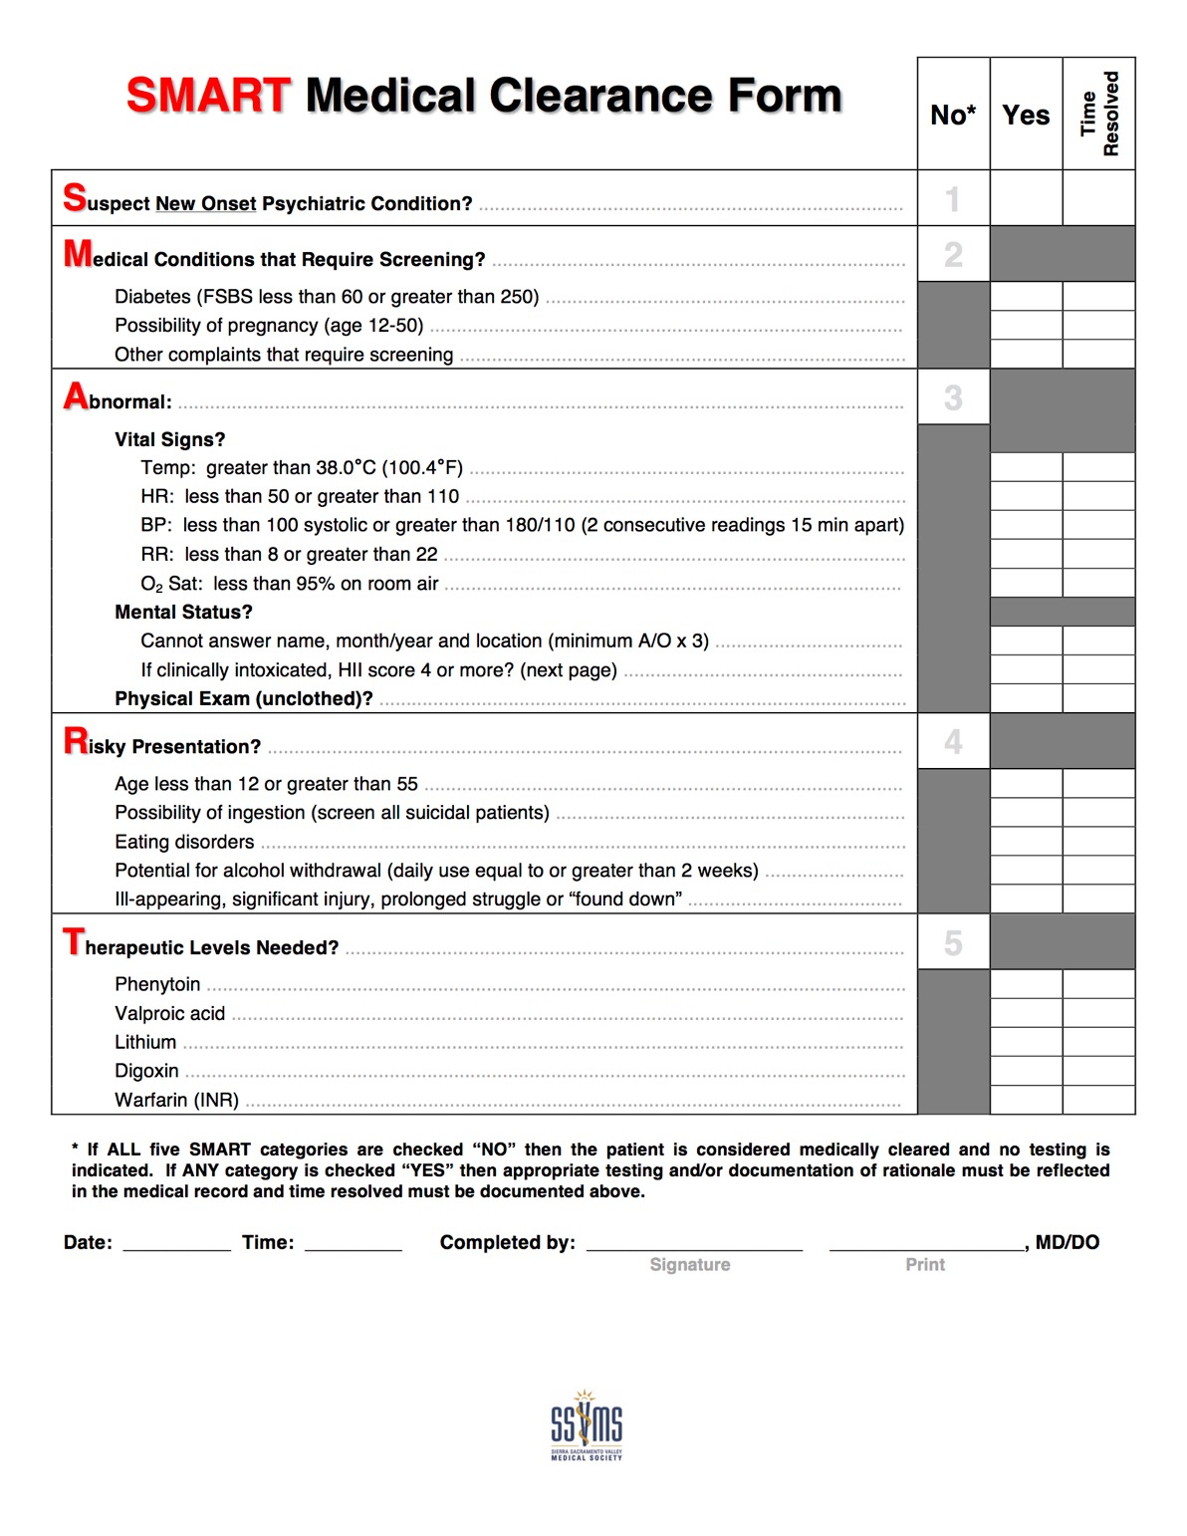


Notes:
SMART document

Slide 26
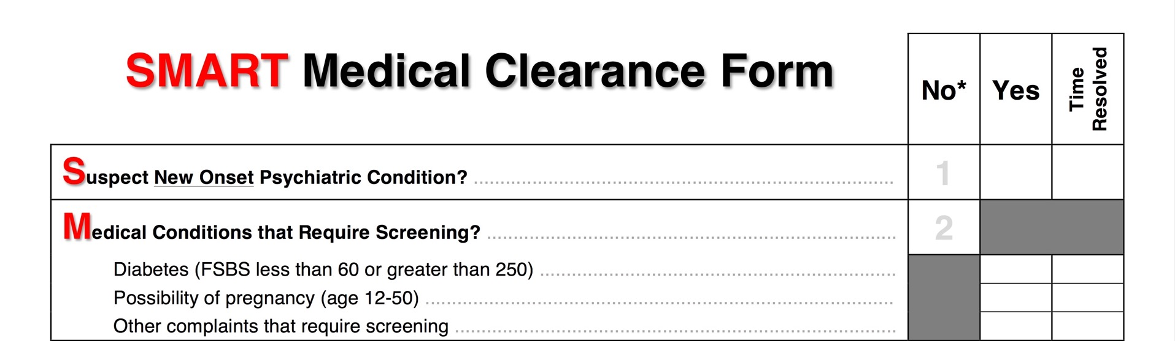
Notes:
What is SMART and what does it stand for?

Slide 27
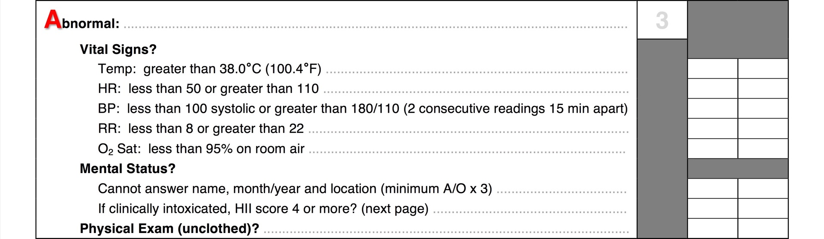
Notes:
What is SMART and what does it stand for?

Slide 28
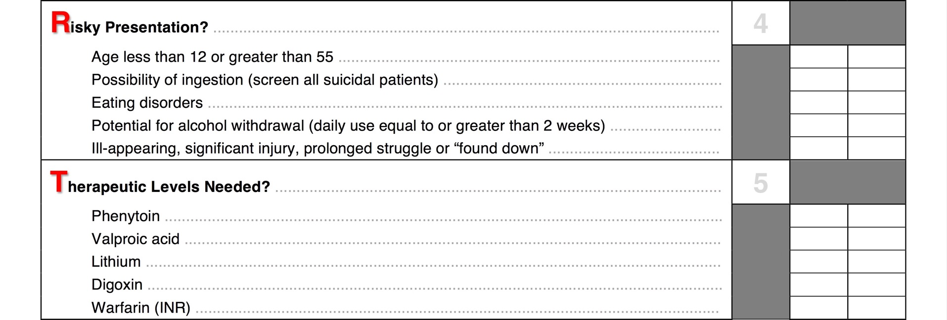
Notes:
What is SMART and what does it stand for?

Slide 29
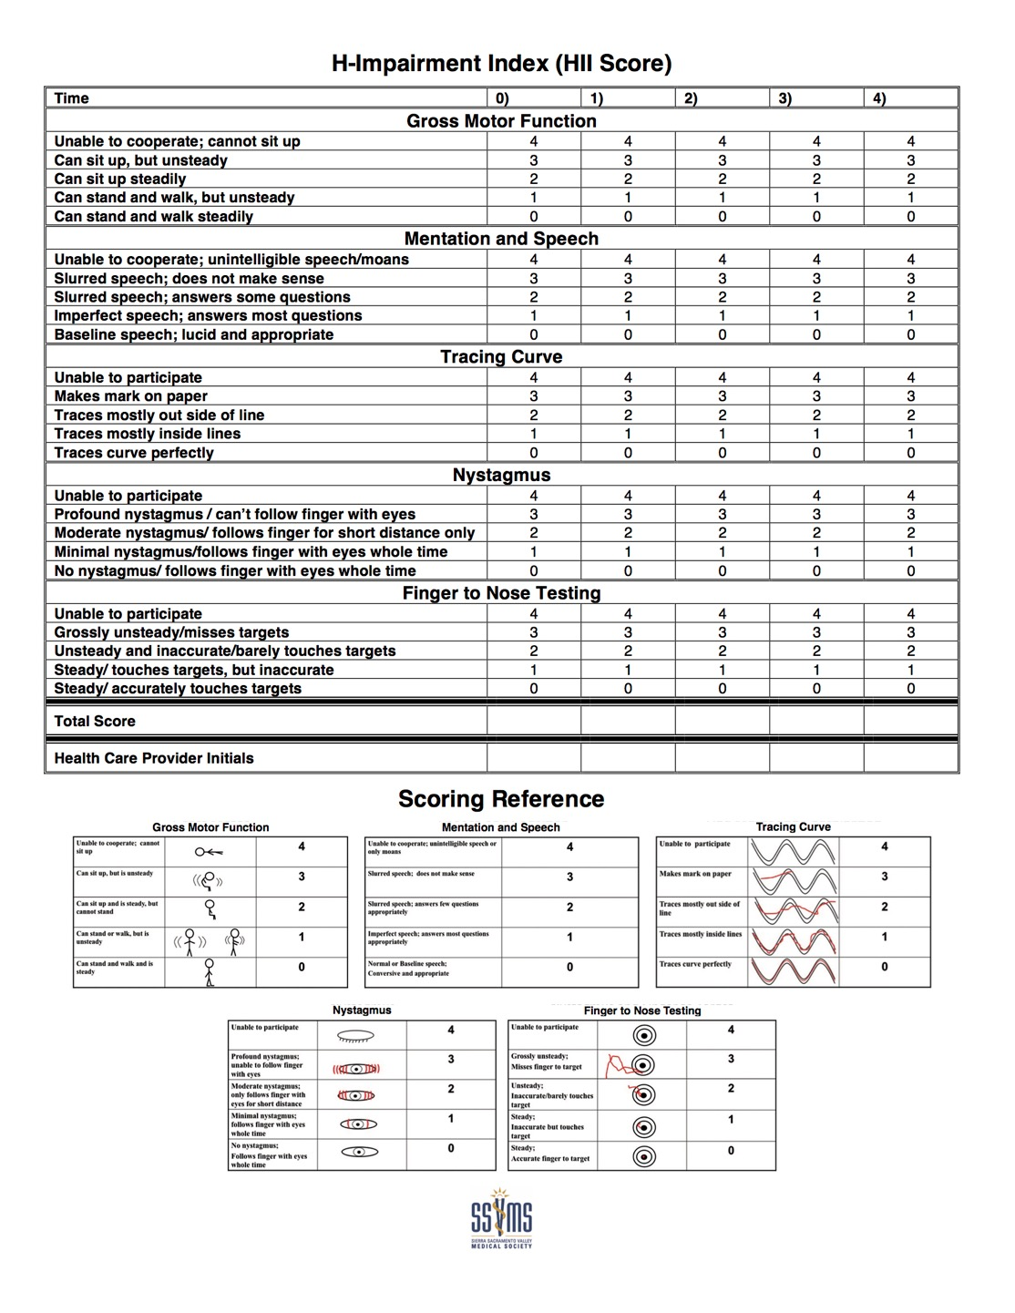
  HII Score

Slide 30
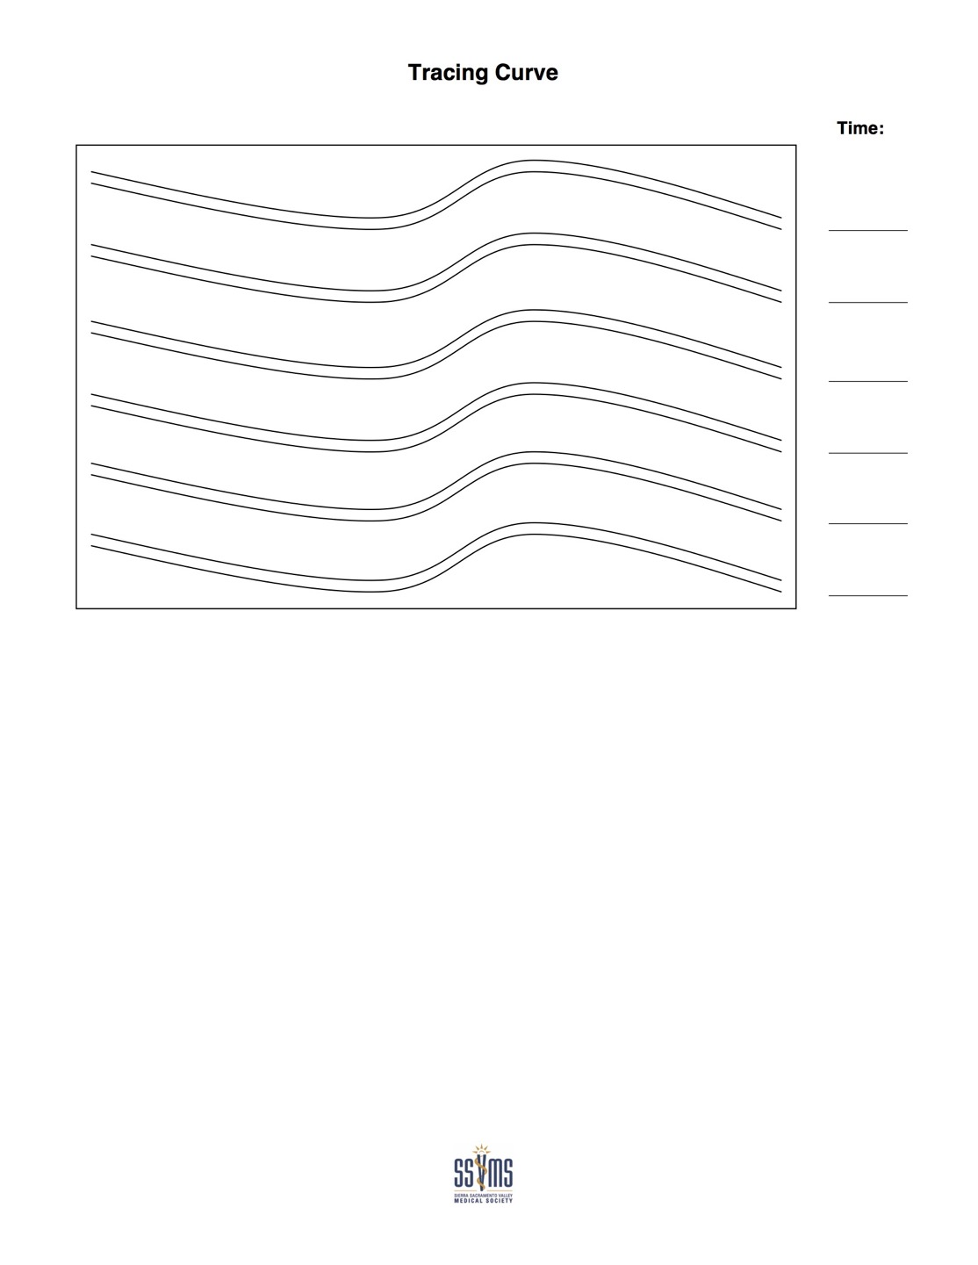
  Tracing Curve

Slide 31
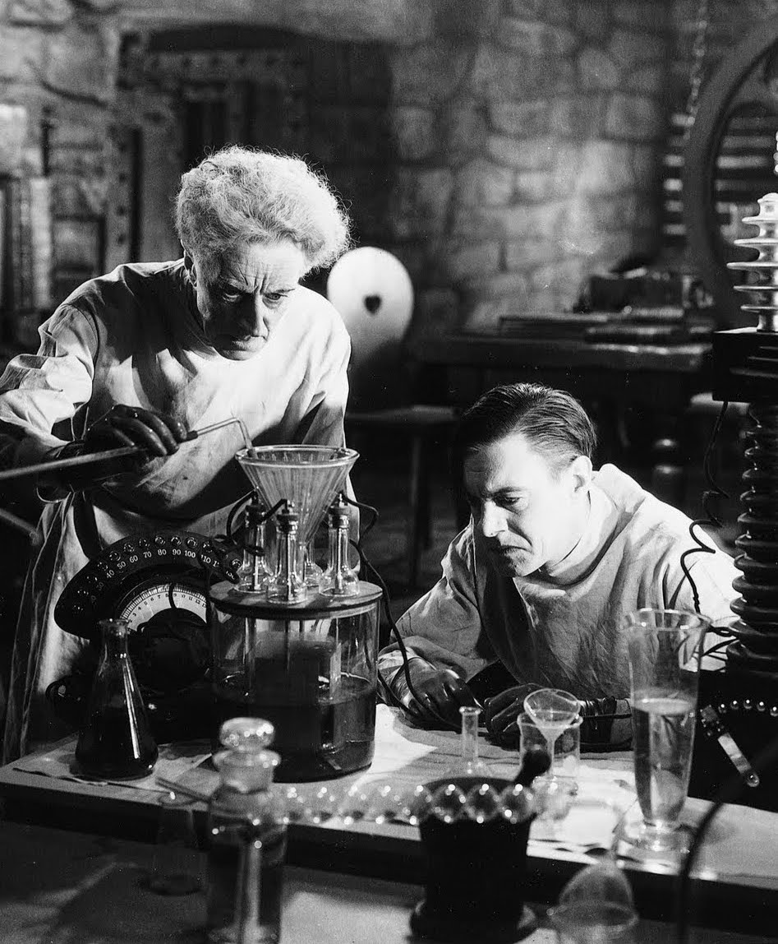
  Validation Data
  209 patients
  2 facilities
  1.4% miss rate

Slide 32


  Validation Data
  Reduced testing by 59.9%
  Expedited MSEs
  Better assessments

Slide 33


  Transparency
  Collaboration
  Robust peer review
Notes:
Transparency
Collaboration
Robust peer review commitment

Slide 34
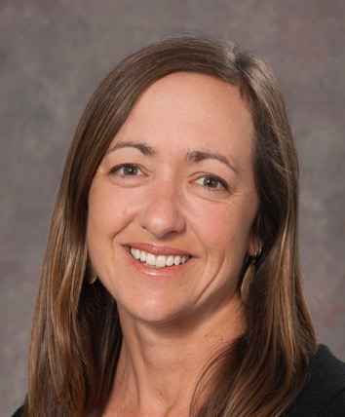

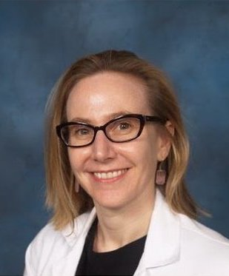

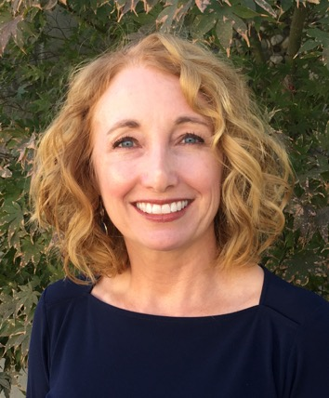
  SMART Team
  Amy Barnhorst, MD
  Kevin Jones, DO
  Aimee Moulin, MD
  Seth Thomas, MD
  Aileen Wetzel

Slide 35

  Current Performance
  3 EDs fully implemented
  5 psych hospitals
  Est. > 6,000 patients
  Ongoing research

Slide 36
  SMART implemented
Notes:
Scrolling

Slide 37
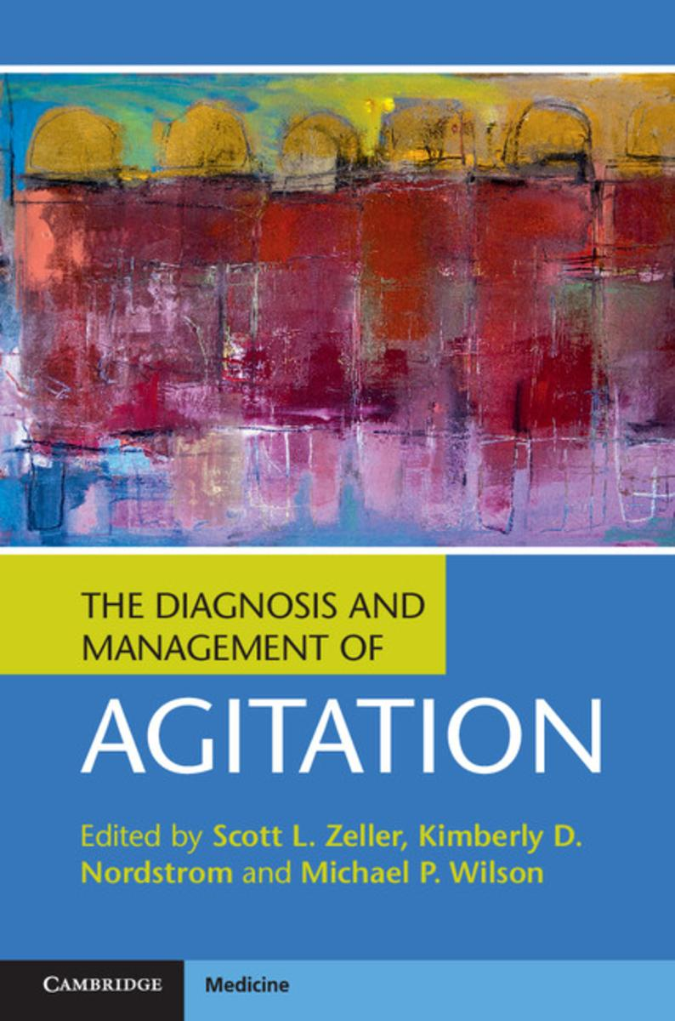
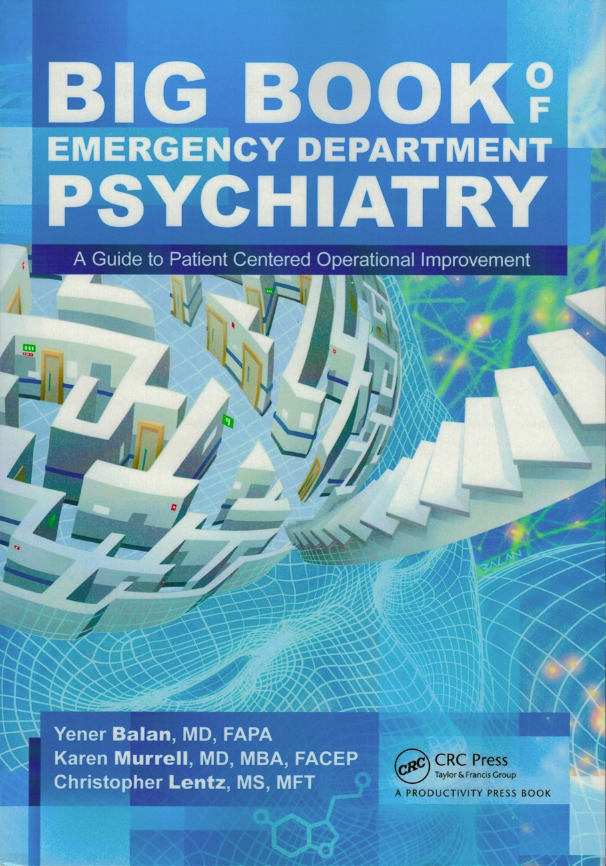
Notes:
Books

Slide 38
  Lessons & Landmines
  SMART is not a shortcut
  Leverage transparency & collaboration
  Be consistent & conservative
  Be a good neighbor
Notes:
Scrolling

Slide 39

  Be THE Agent of Change
  Start the conversation
  Put the patient first
  Use the resources available
  Be transparent & collaborative
Notes:
Scrolling

Slide 40
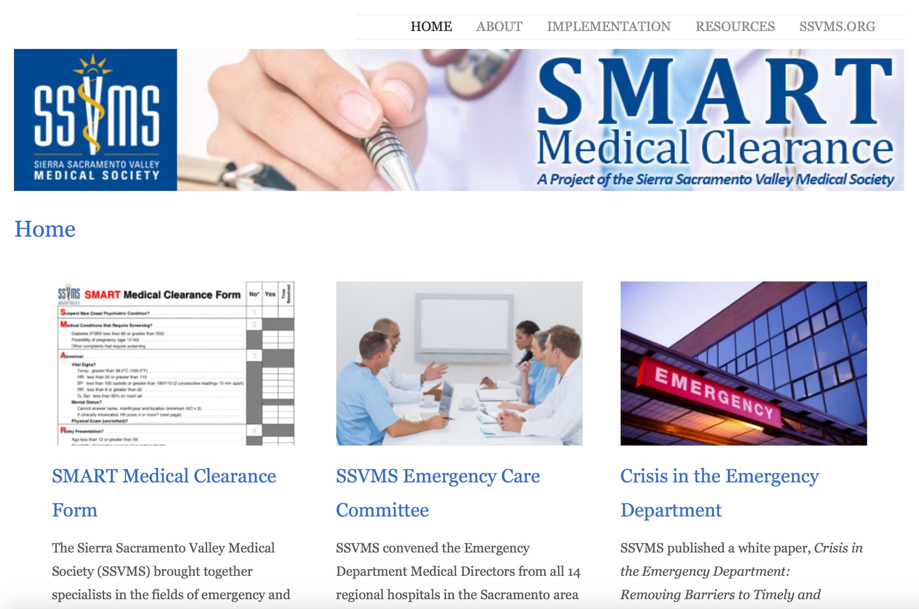
  smartmedicalclearance.org
Notes:
Website

Slide 41
  Available in EPIC as…
  .EDSMART

Slide 42
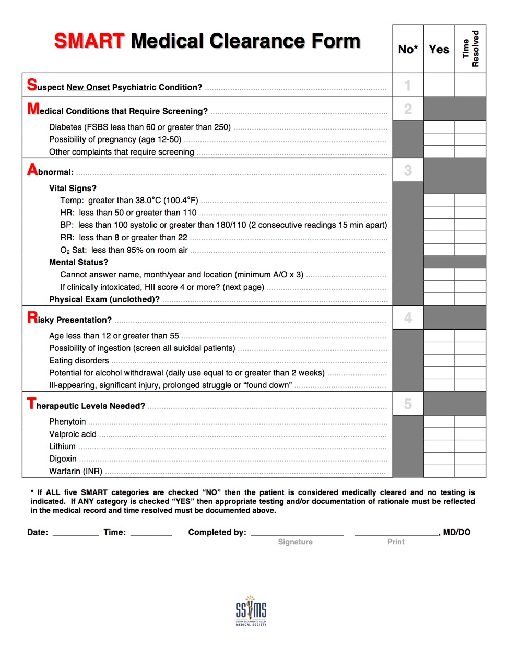
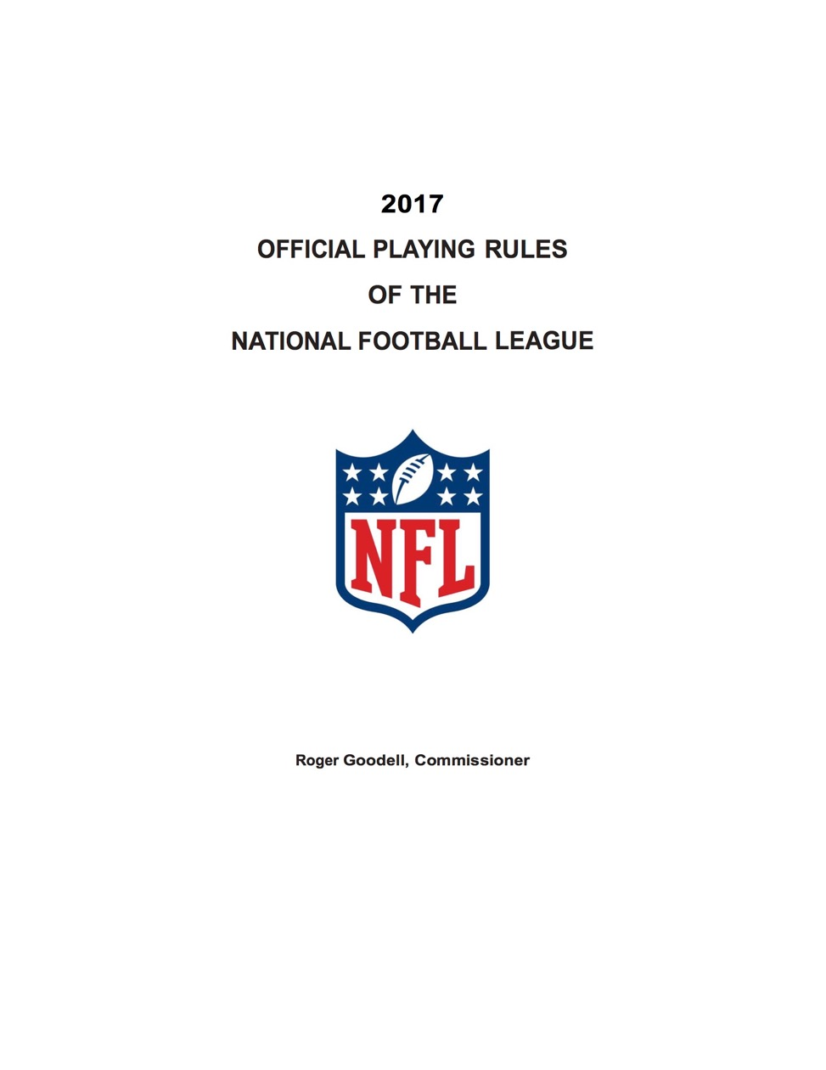
Notes:
2017 NFL rule book has 18 “rules” and is 85 pages long.
SMART has 5 main “rules” and fits on one page.

Slide 43
Notes:
2017 NFL rule book has 18 “rules” and is 85 pages long.
SMART has 5 main “rules” and fits on one page.

Slide 44
  Thank You

Slide 45
  Questions?
  Email:
  SethThomas@cep.com

