Slide 1
SMART Medical Clearance Training

Slide 2
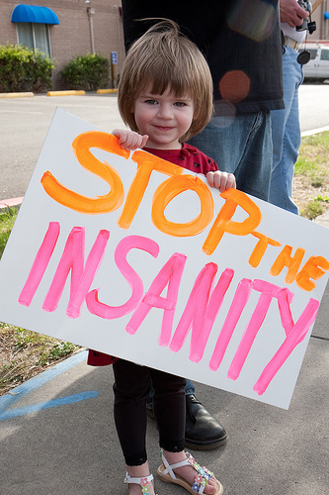
Why change the medical clearance process?
In order to…
Promote patient safety
Reduce harm
Reduce unnecessary testing
Reduce unnecessary delays
Reduce cost

Slide 3
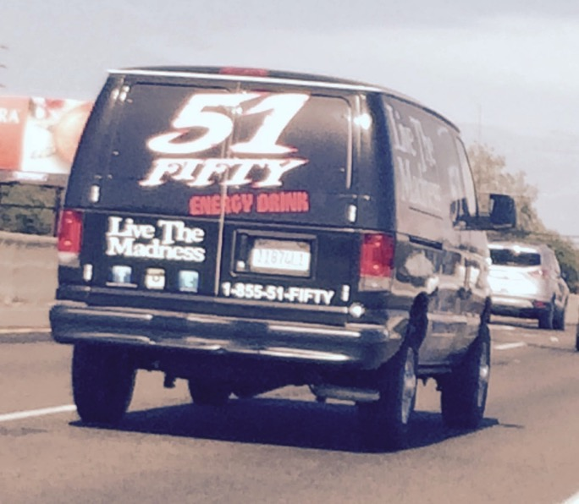
How should we do it?
By advancing the current blind panel-ordering process using evidence based medicine, standardization and collaboration
By implementing the SMART medical clearance tool

Slide 4
What is SMART Medical Clearance?
A new standardized medical clearance tool
Eliminates the reliance on indiscriminate and wasteful psych lab order sets
Promotes standardized and expedited medical clearance, when appropriate, for mental health patients in acute crisis
Evidence-based & vetted by peers (SSVMS’ Emergency Care Committee and Mental Health Task Force)

Slide 5
SMART Medical Clearance
Was validated at Mercy San Juan Medical Center (MSJMC) & UC Davis Medical Center (UCD)
Will expedite medical clearance for some patients in a SAFE manner when strictly followed
Not intended for patients that don’t require medical clearance (simple anxiety)

Slide 6
SMART Medical Clearance
Patient safety is priority #1
Must be filled out COMPLETELY and signed by the treating provider
Forces a thorough H&P and thoughtful, selective testing
If all categories marked as “No” then patient will be considered “medically cleared”

Slide 7
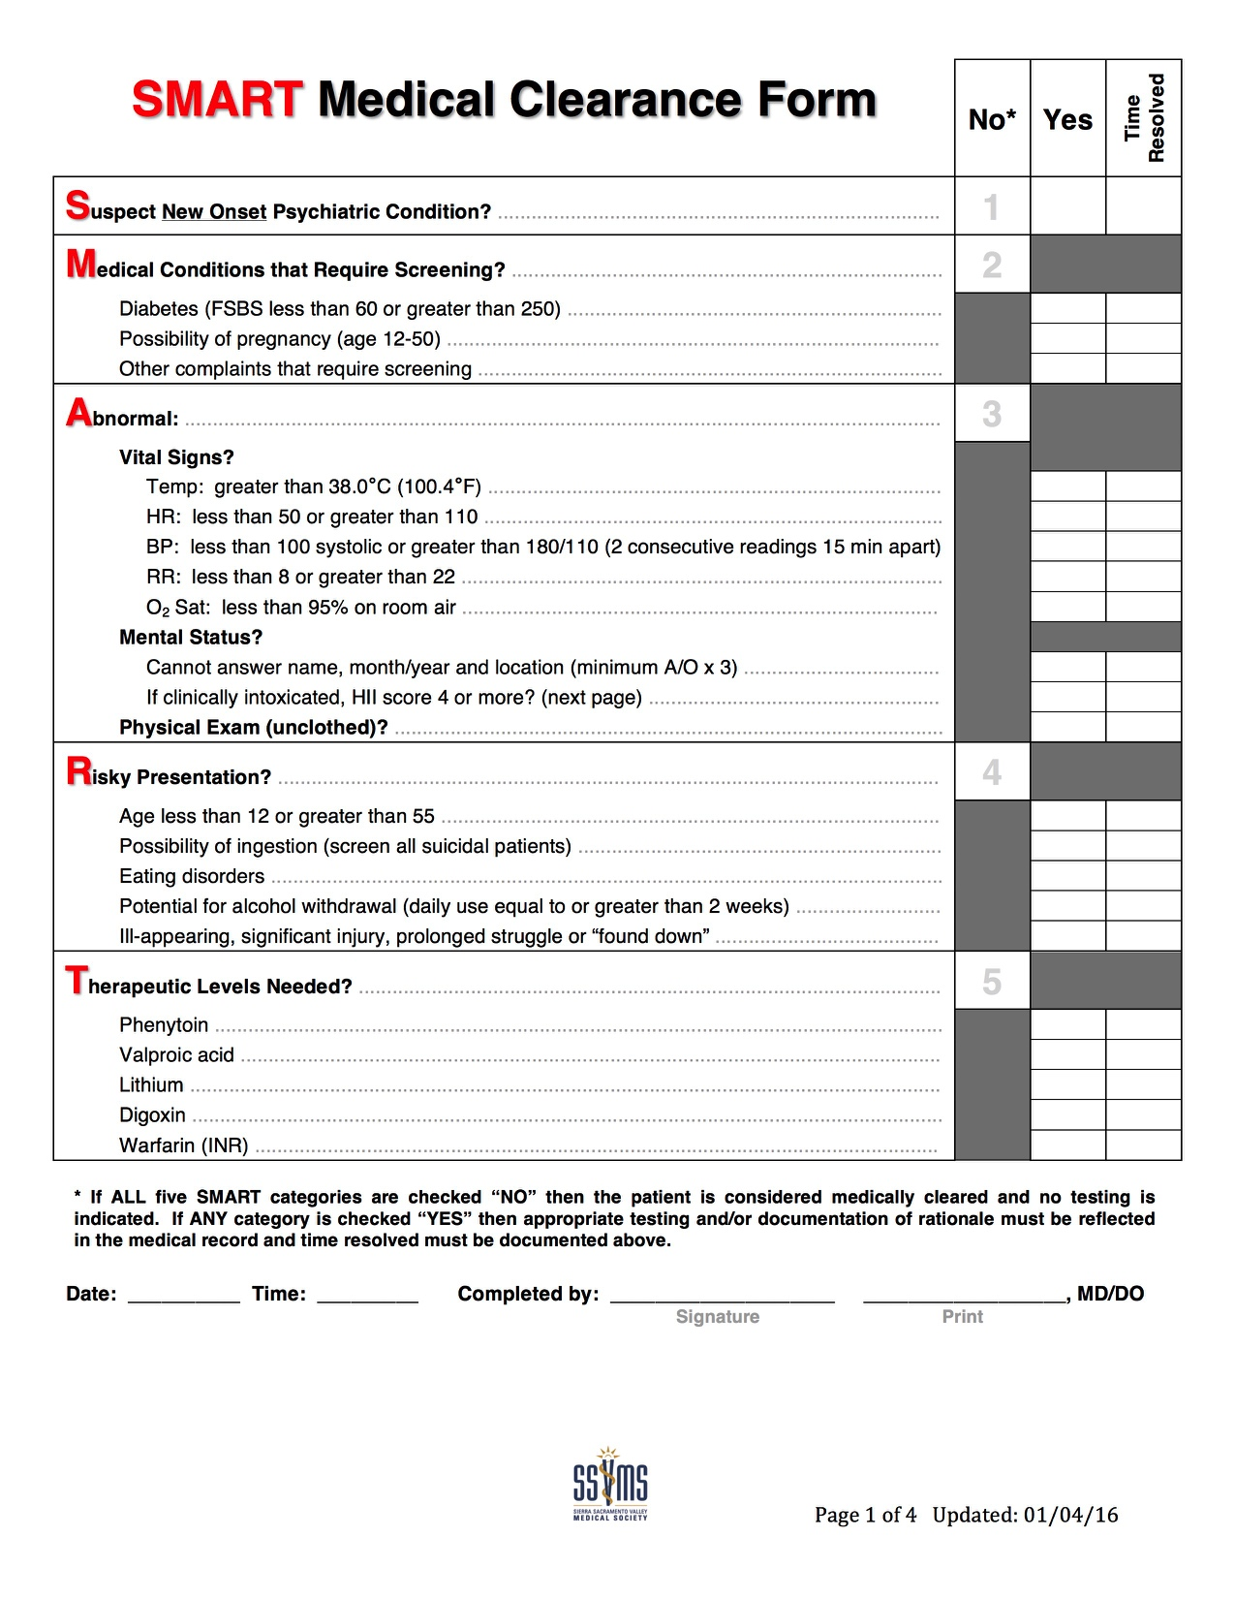
Page 1
Five “SMART” categories
Must be “No” to pass
Any “Yes” must be evaluated and addressed by further exam, clear rationale or diagnostic evaluation
Time of resolution must be documented and initialed

Slide 8
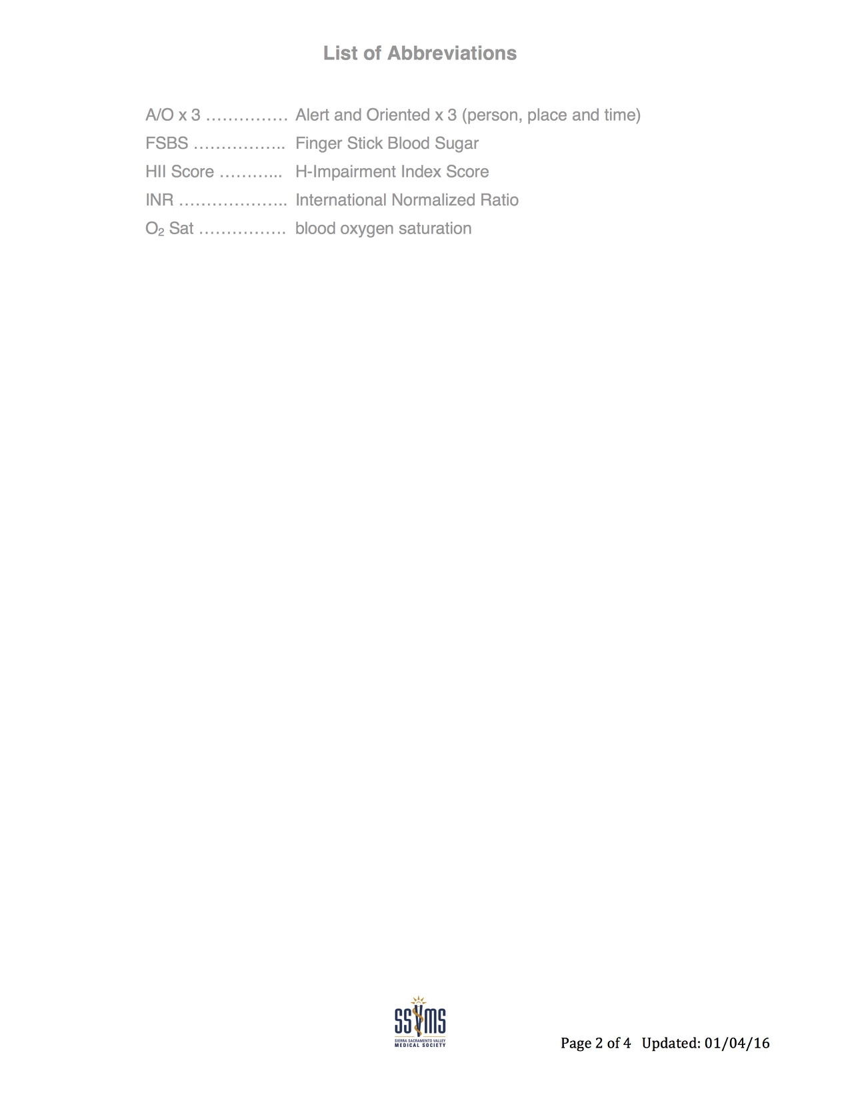
Page 2
Abbreviations

Slide 9
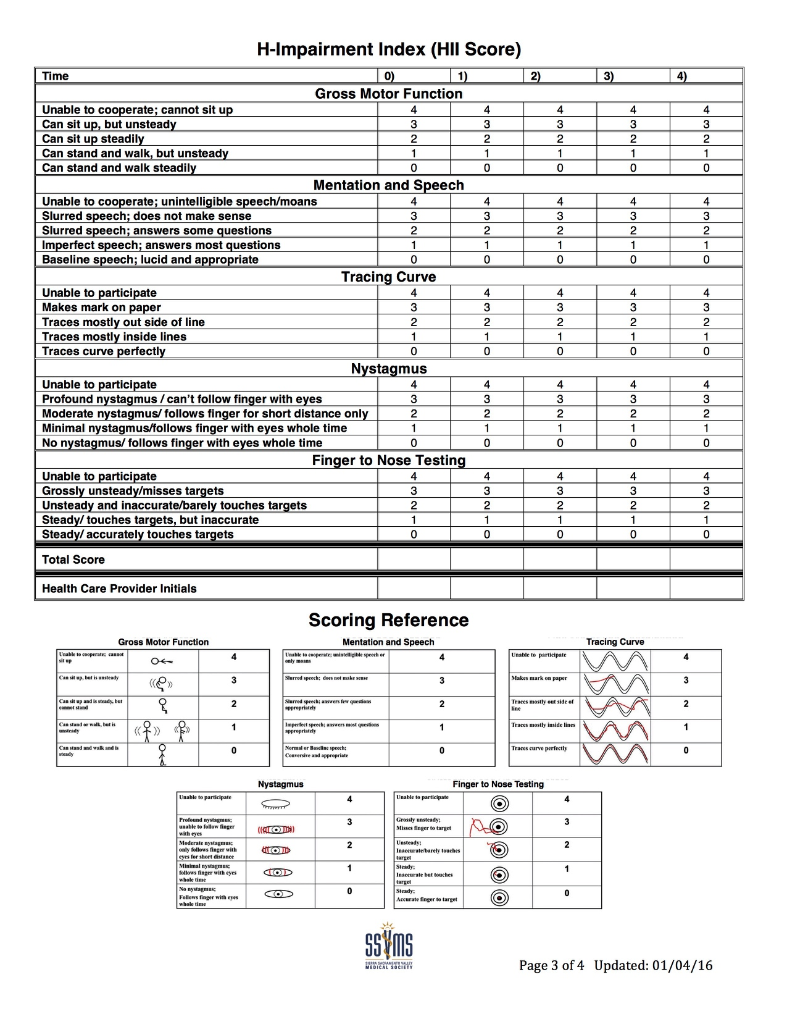
Page 3
If inebriation is suspected, HII score must be completed by the provider
Must be repeated until score is less than 4
All entries must be timed and initialed

Slide 10
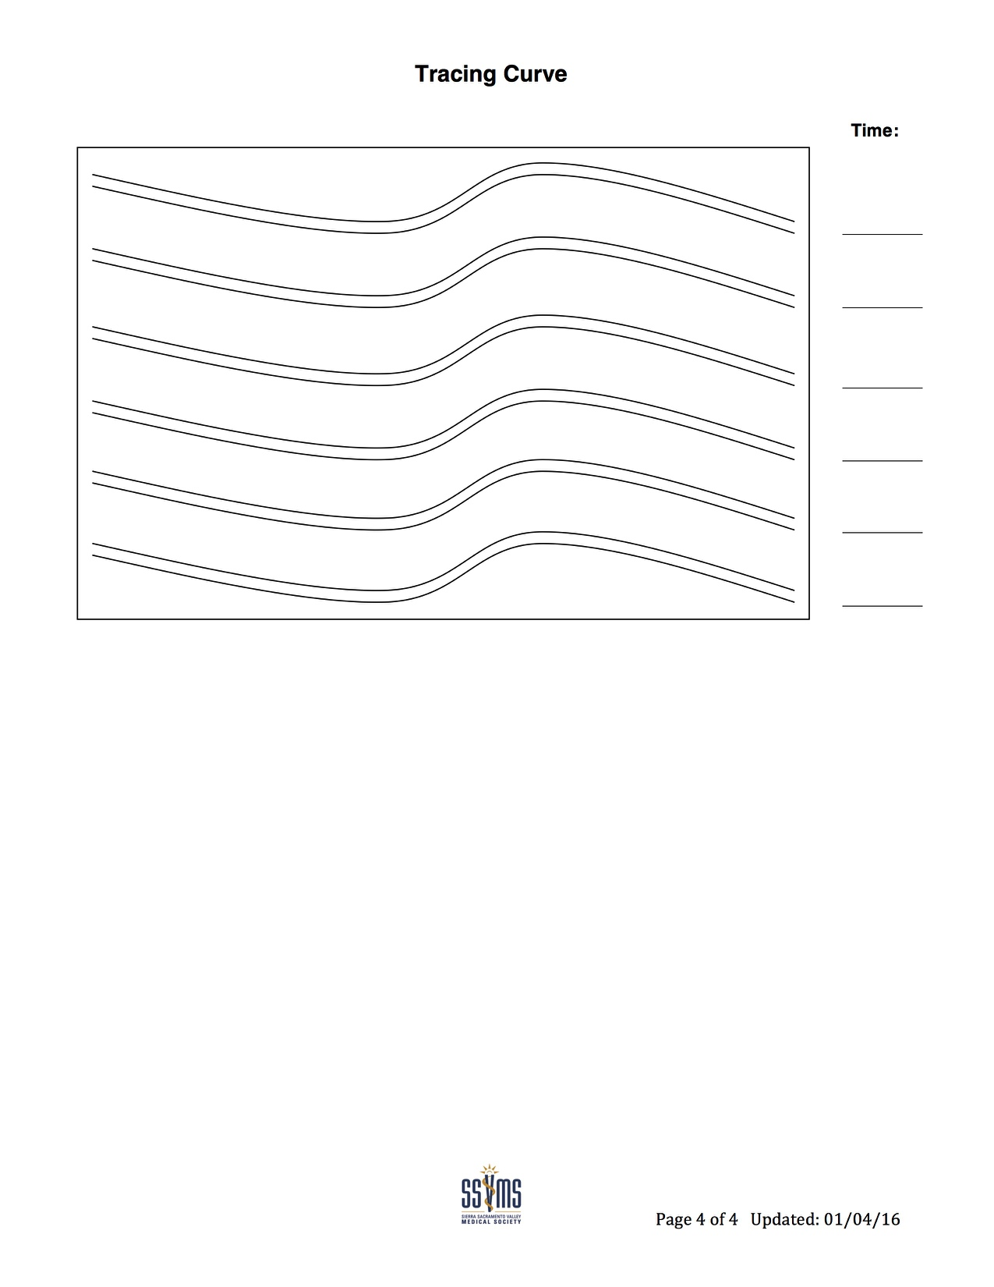
Page 4
Tracing curve
Entries must be timed to correlate with corresponding HII score

Slide 11
SMART Reminders
The SMART Medical Clearance process is NOT:
A shortcut to more rapid medical clearance of patients
The SMART Medical Clearance process IS:
A process to consistently, safely and efficiently guide your focused medical assessment of mental health patients

Slide 12
Implementation Must Haves…
Identify champions (physicians, RNs, SWs, psychiatrists)
In-person training for physicians to emphasize the importance of a standardized, conservative approach
Training & competency for RNs on HII score
QI program oversight at your facility to interface to track:
Misses, bounce backs, misuse or abuse of the form

Slide 13
SMART Implementation Pearls
Be very conservative with “subjective” sections (use FAQs to guide you)
Have a low threshold for excluding delirium
Screen ALL patients with suicidal ideation (acetaminophen and salicylate levels)
Comprehensively review medication lists…don’t miss necessary levels

Slide 14
SMART Implementation Pearls
Best Practice: Initiate home medications immediately, especially the following categories:
Psych, anti-hypertensives, diabetic
Initiate alcohol withdrawal protocols immediately
Urine tox screens are optional (can be helpful for risk stratification but should never exclude patients from evaluation, treatment or acceptance)

Slide 15
SMART Implementation Pearls
Be a Good Partner: Work with your local accepting psychiatric facilities to address their concerns
Don’t be Difficult: If they are not comfortable with a particular patient’s presentation, even if they pass the SMART clearance form, help them by obtaining the diagnostic tests that they need

Slide 16
SMART Questions/Feedback/Suggestions to: Seth Thomas, MD, FACEP
SethThomas@cep.com
Questions on facility engagement to: Aileen Wetzel, SSVMS
awetzel@ssvms.org

